Slide 1


Introduction to Operating Systems
ILIA STATE UNIVERSITY
Paata Gogishvili
Doctor of Informatics
Associate Professor
School of Technology
March 25, 2023
Faculty of Business, Technology and Education

Slide 2
Lecture Topics
Shell - basic commands and file permissions, File System Basics, Soft Link, Hard Link, File, Folder/Directory, Sticky Bit
Linux Installation on KVM
ILIA STATE UNIVERSITY

Slide 3
File System
In a computer, a file system is the way in which files are named and where they are placed logically for storage and retrieval. Without a file system, stored information wouldn't be isolated into individual files and would be difficult to identify and retrieve.
The file, as we already know, is an abstraction of the OS. The hardware is not aware of the files.
ILIA STATE UNIVERSITY

Slide 4
How File Systems Work
A file system stores and organizes data and can be thought of as a type of index for all the data contained in a storage device. These devices can include hard drives, optical drives and flash drives.
File systems specify conventions for naming files, including the maximum number of characters in a name, which characters can be used and, in some systems, how long the file name suffix can be. In many file systems, file names are not case sensitive.
Before files and directories are created on the storage medium, partitions should be put into place. A partition is a region of the hard disk or other storage that the OS manages separately. One file system is contained in the primary partition, and some OSes allow for multiple partitions on one disk. In this situation, if one file system gets corrupted, the data in a different partition will be safe.
ILIA STATE UNIVERSITY

Slide 5
Meta Data of The File System
File systems use metadata to store and retrieve files. Examples of metadata tags include:
Date created
Date modified
Last date of access
Last backup
User ID of the file creator
Access permissions
File size
Metadata is stored separately from the contents of the file, with many file systems storing the file names in separate directory entries. Some metadata may be kept in the directory, whereas other metadata may be kept in a structure called an inode.
ILIA STATE UNIVERSITY

Slide 6
The File Access
File systems can also restrict read and write access to a particular group of users. Passwords are the easiest way to do this. Along with controlling who can modify or read files, restricting access can ensure that data modification is controlled and limited.
File permissions such as access or capability control lists can also be used to moderate file system access. These types of mechanisms are useful to prevent access by regular users, but not as effective against outside intruders.
ILIA STATE UNIVERSITY

Slide 7
File Systems
FAT (File Allocation Table): This is a simple file system commonly used on USB drives and memory cards. It is widely supported on many different operating systems, including Windows, Linux, and macOS. However, it has limitations in terms of maximum file size and partition size.
NTFS (New Technology File System): This is a file system used by Windows operating systems. It supports large file sizes, long file names, and file compression. It also has advanced features such as file permissions, encryption, and disk quotas.
exFAT (Extended File Allocation Table): This is a file system designed for use on flash drives and other removable storage devices. It supports larger file sizes than FAT and is compatible with both Windows and macOS.
ILIA STATE UNIVERSITY

Slide 8
File Systems
HFS+ (Hierarchical File System Plus): This is a file system used on macOS. It supports file metadata such as resource forks and file permissions. It also has support for file compression and encryption.
APFS (Apple File System): This is a newer file system used on macOS and iOS devices. It is designed for solid-state drives and offers features such as file cloning, snapshotting, and encryption.
ext4 (Fourth Extended File System): This is a file system commonly used on Linux systems. It supports large file sizes and partitions, as well as features such as journaling for improved reliability.
ILIA STATE UNIVERSITY

Slide 9
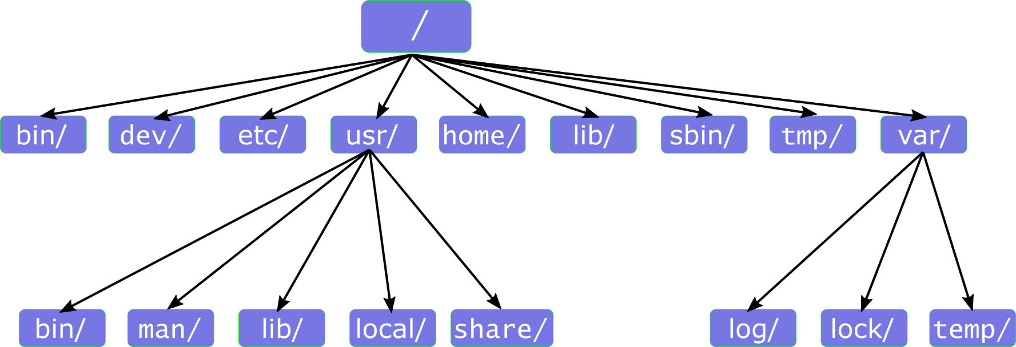
Linux File System
ILIA STATE UNIVERSITY

Slide 10
/bin: Contains essential binary files (executable programs) that are necessary for system operation, such as the ls and cp commands.
/boot: Contains files necessary for booting the system, including the kernel, boot loader, and boot configuration files.
/dev: Contains files representing devices, such as hard drives, USB drives, and printers.
/etc: Contains system-wide configuration files, such as network settings, user account information, and startup scripts.
/home: Contains home directories for individual users.
/lib: Contains shared library files used by system programs and libraries.
/mnt: A mount point directory for temporarily mounting file systems.
/opt: Contains optional software packages that are not installed by default.
/proc: Contains a virtual file system that provides information about system processes and configuration.
/root: The home directory for the root user.
/run: Contains temporary runtime files that are created during system boot and shutdown.
/sbin: Contains essential system administration binaries.
/srv: Contains site-specific data served by the system.
/sys: Contains files representing system devices and configuration.
/tmp: Contains temporary files that are not needed permanently.
/usr: Contains non-essential binaries, libraries, and documentation files.
/var: Contains variable data files, such as log files and temporary spool directories.
ILIA STATE UNIVERSITY

Slide 11
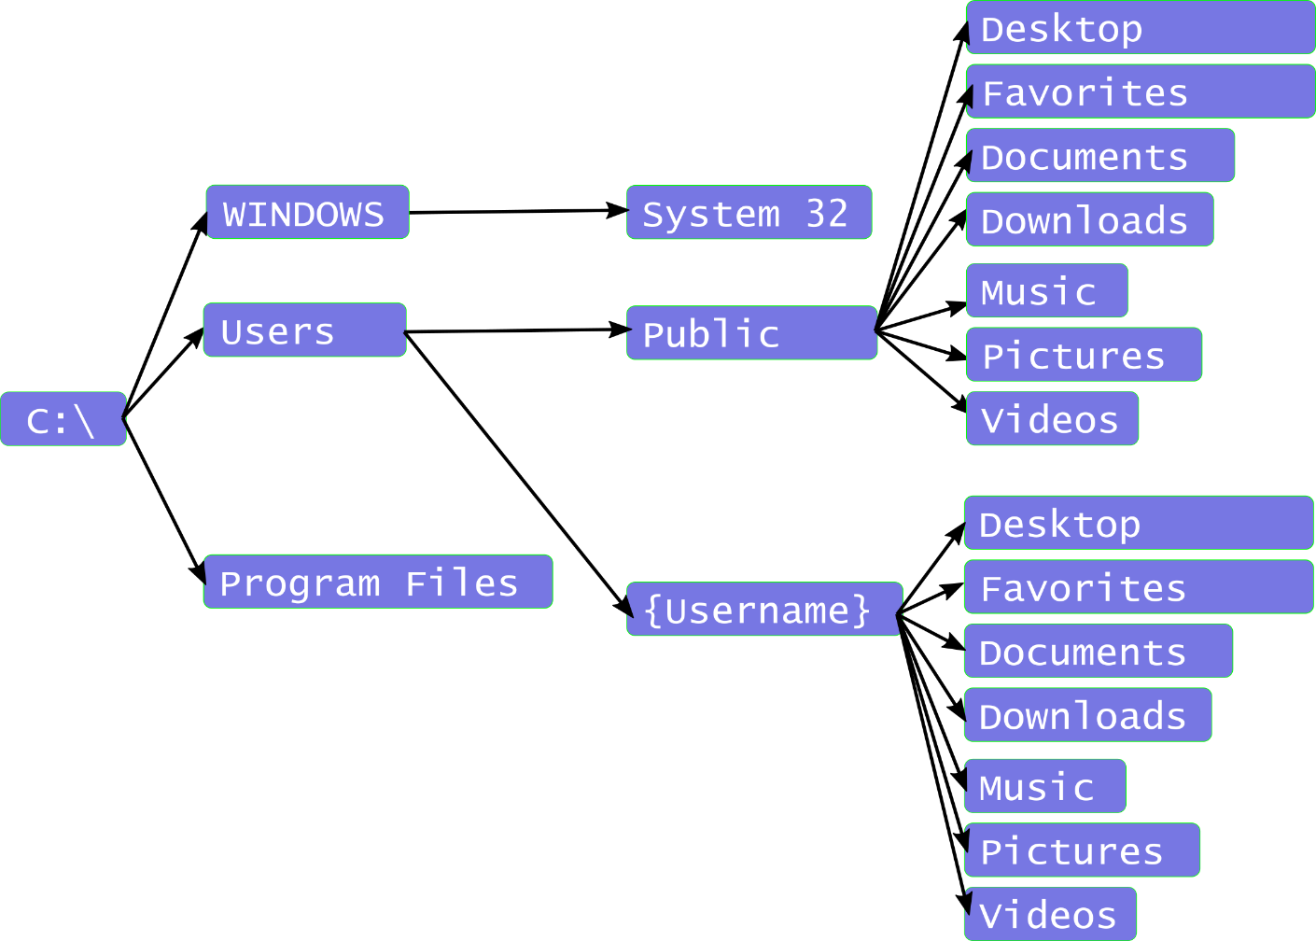
Windows File System
ILIA STATE UNIVERSITY

Slide 12
C:\Windows: Contains the operating system files, including the Windows registry, system files, and device drivers.
C:\Program Files: Contains installed software programs.
C:\Users: Contains user profiles and user-specific data.
C:\ProgramData: Contains data that is shared by all users and programs.
C:\Users\Public: Contains files and folders that are accessible to all users on the computer.
C:\Documents and Settings: This directory is used in older versions of Windows (such as Windows XP) to store user profiles and user-specific data.
C:\Temp: A directory used for temporary files.
C:\Windows\System32: Contains essential system files and libraries used by Windows.
C:\Windows\System32\drivers: Contains device driver files.
C:\Windows\Fonts: Contains installed fonts.
C:\Windows\Installer: Contains installer files for installed software programs.
C:\Windows\Temp: A directory used for temporary files specific to the operating system.
C:\Program Files (x86): Contains installed 32-bit software programs on 64-bit Windows operating systems.
C:\Recovery: Contains system recovery information.
C:$Recycle.Bin: Contains deleted files and folders that can be restored from the recycle bin
ILIA STATE UNIVERSITY

